Slide 1
Case Study
Background
Supermarket Z has bought monthly transactional data of their 2 biggest competitors, merchant X and merchant Y. This includes number of customers, number of transactions and the value of that spend.
There is some demographic data however this is limited to region, age, salary, gender and cross holdings.
The transactional data is from a marketing focus group that have been recording their supermarket spend within supermarket Z and their 2 competitors on their credit or current account.
Each Merchants half yearly revenue results have been included from online publication.
Question
The Product and Marketing Director of Supermarket Z would like to introduce a new spend reward credit card to customers in a bid to :
Gain a share of the credit card market where currently they have no offering, they currently only operate a loyalty card
Drive increased spend in its stores by launching the credit card
Please write a brief PowerPoint presentation (15-20 minutes) to identify and quantify how they can best achieve their objectives
Make any assumptions, or, future need for additional information clearly known within the presentation

Slide 2
Model 1: Regression Model

Slide 3
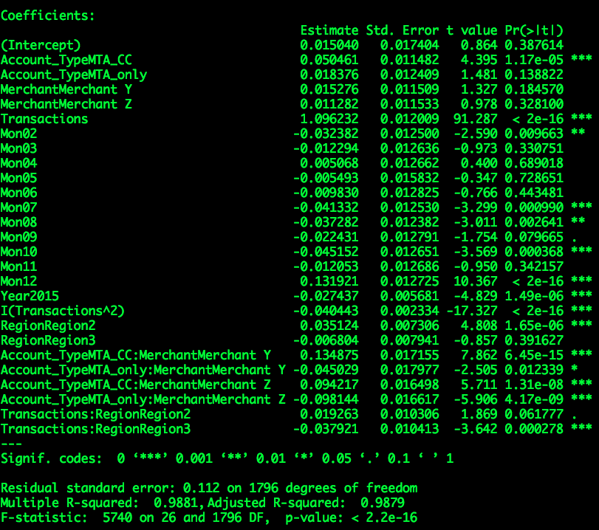
Model Output
The predictors: Region, Transactions, Age, Month, Year and Account_Type explain 98.81% of variability in Spend. The model is non-linear in nature. The model formula is:
Here, β₀ (base) is Account Type:CC_only, Merchant X, Mon01, Region1, Year2014, A.T: CC_only: Merchant X, and Transactions:Region1; β₀ = 0.015, and it’s not significant as there is not any sufficient statistical evidence that it's different from zero.
Each coefficient represents the additional effect of adding that variable to the model, if the effects of all other variables in the model are already accounted for.

Slide 4
Model Interpretation
Here, β₀ (reference) is Account Type:CC_only, Merchant X, Month 1, Region1, Year2014, Account_Type: CC_only: Merchant X, and Transactions:Region1.
The mean effect of Transactions on Spend: β₅Transactions - β₁₈I(Transactions^2) = £3,568
For every 1-unit increase in Transactions, the mean effect in spend is an increase by £3,568 calculated as: (1.096*sd + mean)or £6295; less (– 0.040443 * sd +mean) or - £2,726, here the gain decreases as the square term of Transaction is negative.
The mean effect of 1-unit increase of December month in 2014 on Spend:
0.131921* Mon12, or (0.131921*sd+mean) or £57,544.
The mean effect of 1-unit increase in Account Type: MTA_CC for Merchant Y on Spend in Region 3 and taking into account Year 2015:
0.050461 * A.T:MTA_CC + 0.015276 * Merchant Y - 0.006804 * Region3 + 0.134875 * A.T:MTA_CC : Merchant Y - 0.027437* Year2015, or £52,822 + £50,780 - £50,287 + £57,718 - £51,482 = £59,551
The coefficient (β₁) of A.T:MTA_CC is the average difference in Y between the category for which β₁ = 0 (the reference group) and the category for which β₁ = 1 (the comparison group). The average spend would increase by £59,551.
Notes:
0.131921*58008 + 49893 = 57,544
0.0505 * 58007.84 + 49893.47 = 52,822
0.0153 * 58007.84 + 49893.47 = 50,780
0.0068 * 58007.84 + 49893.47 = 50,287
0.1349 * 58007.84 + 49893.47 = 57,718
0.0274 * 58007.84 + 49893.47 = 51,482

Slide 5
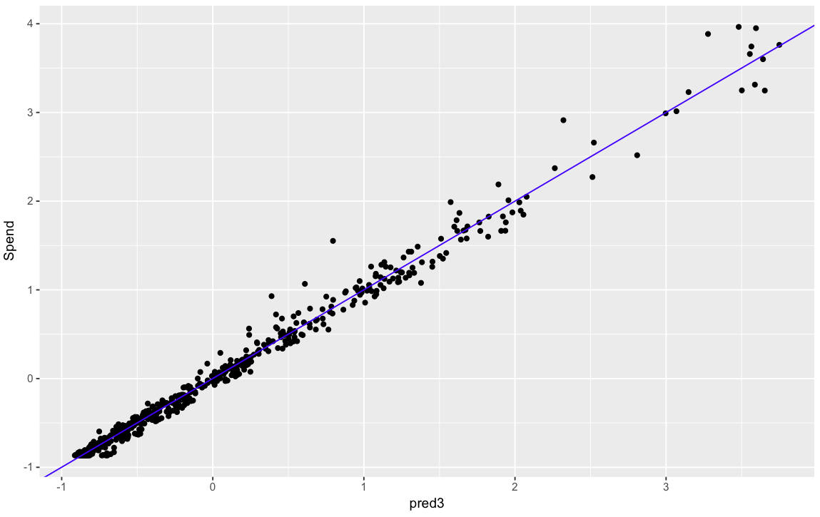
Plotting ground truth vs. predictions
Model trained on 75% of data. By testing the model on 25% of data, the RMSE is 0.1017. RMSE explains, how much spread exists in the errors of it's predictions.
Plotting ground truth vs. predictions on right reveal a well-fitting model.
Multi-collinearity in the model is removed by not taking into account: Customers. Savings A/C, Age, and Merchant are not significant. October and December are most significant months.

Slide 6
Model 2: Random Forest Model

Slide 7
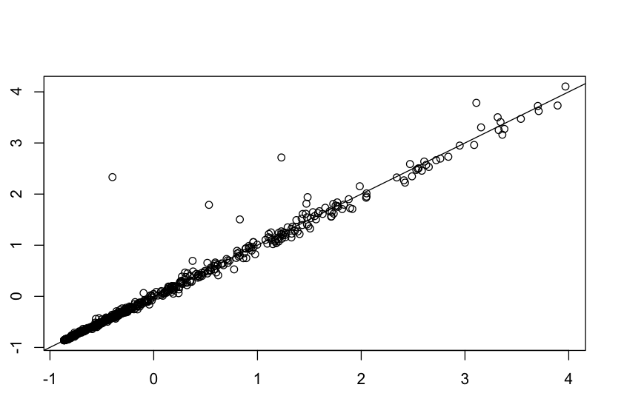
Random Forest Model
Another method used for predictions of spend is Random Forest.
The RMSE for this model is 0.1591983.
And here too, the predictions line up close to original Spend.
X-axis is predicted Spend, and Y-axis is original Spend. Values are standardized.
Notes:
rf.pred2 <- randomForest(Spend~.,data=train1,mtry=6, importance=TRUE, ntree=25)

Slide 8
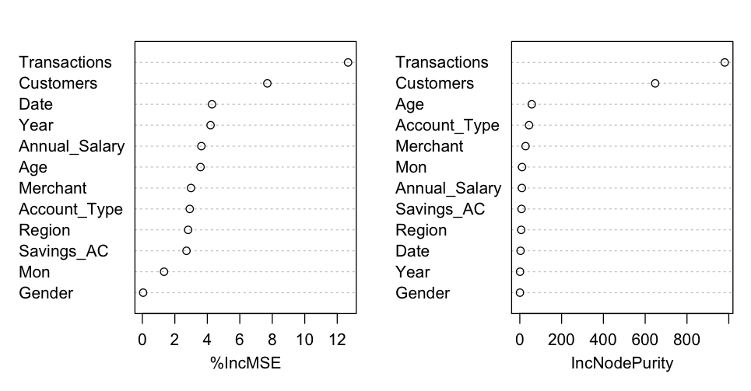
Variable Importance Plot – Random Forest
As per the Variable Importance Plot, Transactions is the most important, and Gender is the least important variable.

Slide 9
Summary of Predictive Modeling
Total data was split into 75% train and 25% test set.
Out of the two models, multi-linear regression and random forest, the former had the lower RMSE. RMSE is the average square root difference between actual and predicted values using test set.
Multi-linear regression model, explains 98.81% of variability in Spend. Spend is the dependent variable, and rest of the variables are predictors.
As per Random Forest, the five-most important variables are Transactions, Customers, Date, Year, and Annual Salary.

Slide 10
Data Exploration

Slide 11
No Savings A/C: High Spend.
Spend for no Savings A/C on average is £64,000, otherwise it is £34,000 approx.
Spend for MTA_only accounts ranges on average at £86,000, than MTA_CC at £6800. And, average spend for Merchant Z is £52,000.

Slide 12
Age is negatively correlated with Spend, and positively with Salary.
Holders of CC_only have highest average salary of £32000. For Merchant Z, average spend in CC_only is £7769 and average spend in MTA_CC is £61,000 approx.
MTA_only accounts have lowest average salary.
Merchant | Average Spend | Average Salary | Average Transactions | Total
X | 19,639 | 26,807 | 913 | 797
Y | 77,206 | 27,682 | 4,094 | 826
Z | 51,792 | 28,124 | 2,707 | 818
Merchant | Account_Type | Average Spend | Average Salary | Average Transactions | Total
X | CC_only | 2,290 | 31,707 | 86 | 245
X | MTA_CC | 18,855 | 27,738 | 766 | 276
X | MTA_only | 35,822 | 22,981 | 1,794 | 276
Y | CC_only | 9,772 | 32,124 | 443 | 274
Y | MTA_CC | 83,498 | 28,368 | 3,869 | 276
Y | MTA_only | 137,859 | 23,359 | 7,944 | 276
Z | CC_only | 7,769 | 32,376 | 348 | 266
Z | MTA_CC | 60,831 | 28,947 | 2,725 | 276
Z | MTA_only | 85,181 | 23,974 | 4,963 | 276
(Average spend, average Transactions and average salary are in £)

Slide 13
The peaks & troughs in spend for Merchant Y & Z is similar. Z can capitalize based on Y’s trajectory.
Merchant | Year | Average Spend | Average Transactions | Total
X | 2014 | 16,435 | 712 | 380
X | 2015 | 22,558 | 1,096 | 417
Y | 2014 | 63,660 | 3,223 | 394
Y | 2015 | 89,560 | 4,889 | 432
Z | 2014 | 43,636 | 2,152 | 389
Z | 2015 | 59,188 | 3,211 | 429
Merchant Z has an average Spend of £59,000. In 2015, Z had a growth of 36% in Spend, whereas as Y and X had 41% and 37% growth respectively. (Average Spend and Average Transactions are in £)

Slide 14
MTA_only has the highest transactions in Region 3, followed by MTA_CC

Slide 15
Customers with largest Spend do not have Savings A/C.
Merchant | Savings_AC | Average Spend | Average Salary | Average Transactions
X | No | 25,647 | 26,576 | 1,192
X | Yes | 13,144 | 27,108 | 611
Y | No | 101,260 | 27,336 | 5,530
Y | Yes | 53,034 | 28,070 | 2,651
Z | No | 66,385 | 27,781 | 3,595
Z | Yes | 36,839 | 28,523 | 1,798
Customers with no Savings A/C have 2x spend for X and Y.

Slide 16
Driving higher Average Transaction Size (ATS) and Spend Per Customer (SPC) is important
SPC | CC_only | MTA_CC | MTA_only
X | 67 | 72 | 59
Y | 99 | 114 | 83
Z | 78 | 98 | 70
ATS
X | 30 | 25 | 21
Y | 26 | 23 | 18
Z | 22 | 23 | 18
ATS for Z is 36% lower than X for Credit Card only account, 8% lower in MTA_CC account and 16% lower for MTA_only account.
SPC for Z is 27% lower than Y for Credit Card only account, 14% lower in MTA_CC account and 16% lower for MTA_only account.
(Above figures are in £)

Slide 17
Spend per Customer & ATS has decreased YOY for all Merchants
SPC and ATS for Z is 10% and 7% lower in 2015 than in 2014 respectively.
SPC and ATS for Y is 1% and 0% lower in 2015 than in 2014 respectively.
SPC and ATS for X is 13% and 13% lower in 2015 than in 2014 respectively.
(Figures are in £)

Slide 18
Summary of Data Exploration
Customers with no savings A/C, Spend almost 2x. Spend on average is £64,000, without savings A/C it is £34,000.
Highest number of customers are in age range of 30 and 40. Age is somewhat negatively correlated with Spend.
Holders of CC_only account types have the highest average salary of £32000. For Merchant Z, average spend in CC_only is £7769 and average spend in MTA_CC is £61,000 approx. MTA_only account holders have the lowest average salary.
Merchant Z has an average Spend of £59,000. In 2015, Z had growth of 36% YOY in Spend, whereas as Y and X had 41% and 37% YOY growth respectively.
ATS is lowest for Z. ATS for Z is 36% lower than of X for CC_only accounts, 8% lower in MTA_CC accounts and 16% lower for MTA_only accounts.
MTA_only have the highest transactions in Region 3, followed by MTA_CC.

Slide 19
APPENDIX

Slide 20
Regression Model
Regression Formula:
y = β₀ + β₁A.T:MTA_CC + β₂A.T:MTA_only + β₃MerchantY+β₄MerchantZ+β₅Transactions+β₆Mon02+β₇Mon03+β₈Mon04+β₉Mon05+β₁₀Mon06+β₁₁ Mon07+β₁₂Mon08+β₁₃Mon09+β₁₄Mon10+β₁₅ Mon11+β₁₆Mon12+β₁₇Year2015+β₁₈I(Tran)²+β₂₂Region2 + β₂₃Region3 +β₁₉ A.T:MTA_CC:MerchantY +β₂₀ A.T: MTA_only: MerchantY + β₂₁ A.T: MTA_CC: MerchantZ + β₂₀ A.T:MTA_only: MerchantZ + β₂₁ Transactions: Region2 + β₂₁Transactions:Region3 + ε
Here, β₀ (reference) is Account Type:CC_only, Merchant X, Mon01, Region1, Year2014, A.T: CC_only: Merchant X, and Transactions:Region1; β₀ = 0.015, and it’s not significant as there is not any sufficient statistical evidence that it's different from zero.

Slide 21
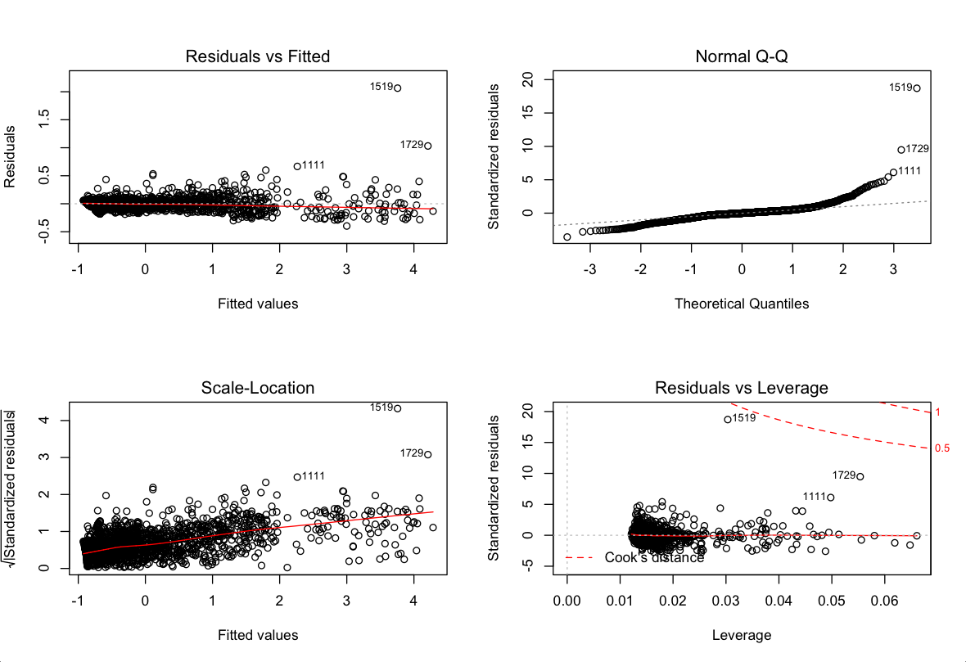
Plotting the Regression Model
Regression Residuals (errors)
The Residuals do not have any discernible pattern.
However, QQPlot reveals, they are not normally distributed.
Salary, Spend, Transactions, and Age variables were also not normally distributed.

Slide 22
Salary distribution is the same for similar Account Types and Customers.

Slide 23
Spend pattern between gender is the same. Spend at Merchant X is lowest.

Slide 24
Distribution of Data: Spend & Transactions is right-skewed

Slide 25
Higher Age, lower Spend; Increase in Salary, decrease in Spend.

Slide 26
Lowest Spend in CC_only accounts & Highest Spend in MTA_only accounts

